Slide 1
Adjustment

Slide 2
Adjustment
Refers to the psychological processes through which people manage or cope with the demands and challenges of everyday life (Witen & Lloyd, 2005)
Adjustment and Adaptation
Adjustment: Internal and External Demands

Slide 3


Slide 4
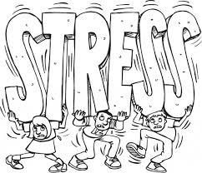

Slide 5
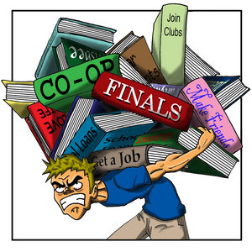

Slide 6
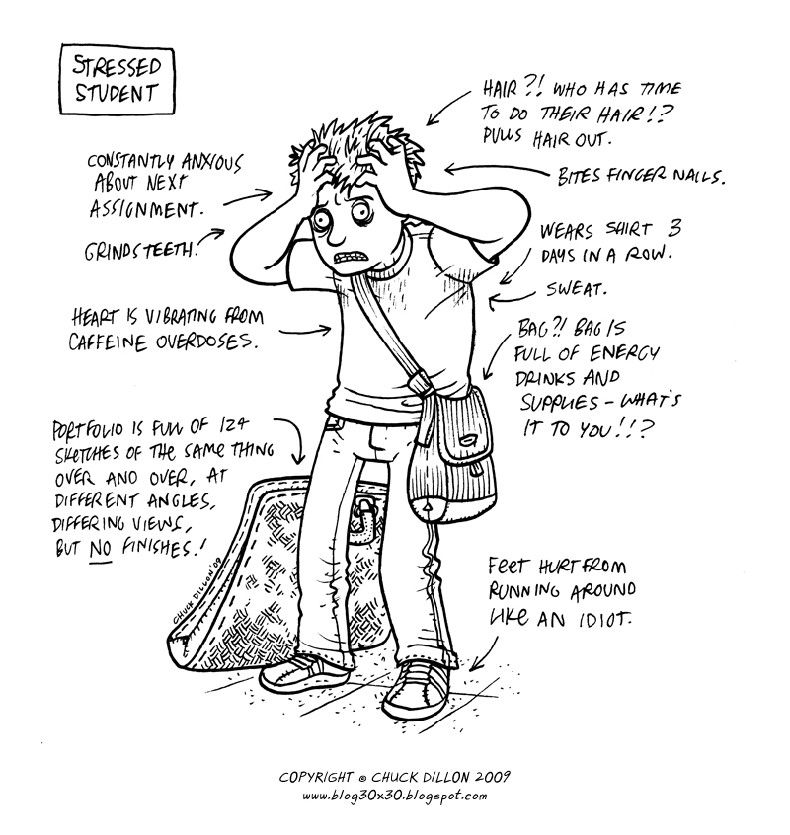

Slide 7
Stress
It is a condition or feeling experienced when a person perceives that “demands exceed the personal and social resources the individual is able to mobilize.”

Slide 8
Stress could be
an individual's response to any challenging, frightening, or difficult situation
an individual’s response or reaction to a real or imagined threat, event or change
a stimulus , response or an interaction between an organism and its environment
be embedded in the environment
be self created or self imposed

Slide 9
Subjective Perception: Stress Lies in the eyes of beholder
Lazarus and Folkman (1984: Appraisal of Stress)
Primary Appraisal: Refers to evaluation whether an event is irrelevant, relevant but not stressful or stressful
Secondary Appraisal: When an event is perceived as stressful it forces an individual to evaluate his/ her available coping resources to deal with the stress

Slide 10
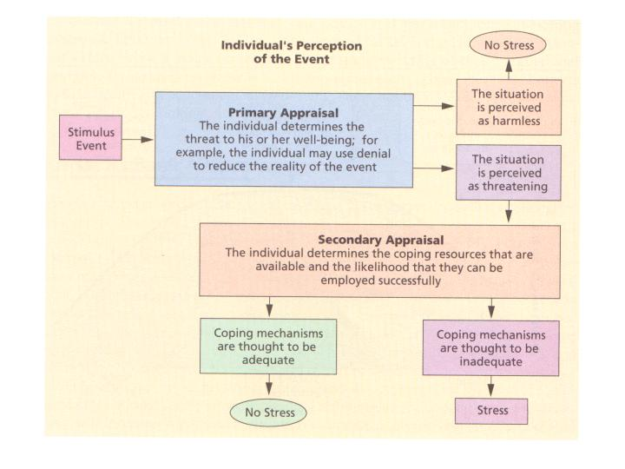

Slide 11
Stressors: Any threat, event or change
Stressors can be internal (thoughts, beliefs, attitudes or external (loss, tragedy, change)
Hans Selye (1956)
“Stress is not necessarily something bad – it all depends on how you take it.”

Slide 12
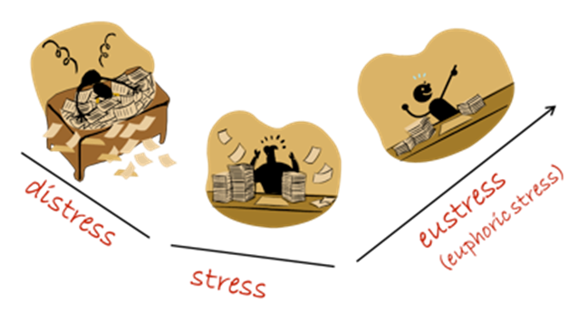
Stress: Two Aspects
Positive Aspect: Eustress
Outcome of Eustress
Enables concentration
Increases performance
Energizes you into motion
Negative Aspect: Distress
Outcome of distress
Causes anxiety or concern
Loss of motivation
Reduces effectiveness
Physical, mental, and behavioral problems
Can lead to mental and physical problems

Slide 13
Top stressors among college students
Relationships
Time Management
Finals and Midterms
Roommates
Finances
Addictions
Family Needs
Lack of Resources
Difficulty Prioritizing
Illness
Social pressures and expectations
Environmental and cultural changes
Loss: Literal loss & Loss of comfort

Slide 14
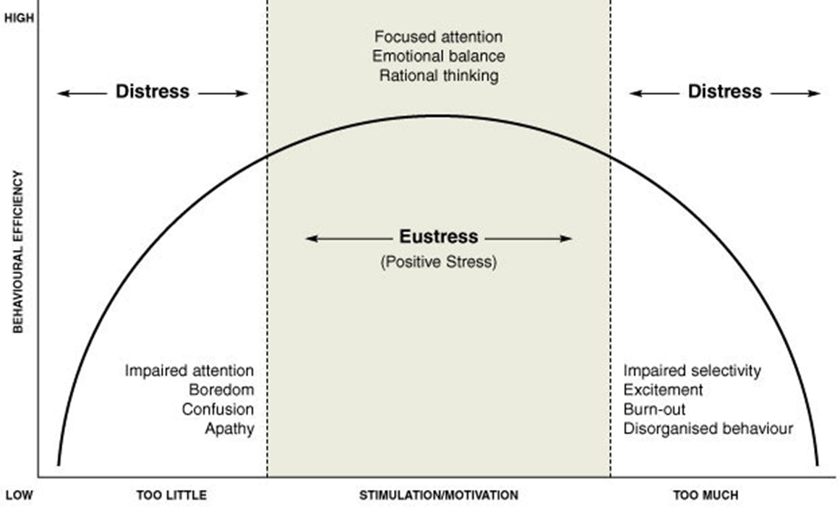
Stress and Performance

Slide 15
Subjective Perception: Stress Lies in the eyes of beholder
Lazarus and Folkman (1984: Appraisal of Stress)
Primary Appraisal: Refers to evaluation whether an event is irrelevant, relevant but not stressful or stressful
Secondary Appraisal: When an event is perceived as stressful it forces an individual to evaluate his/ her available coping resources to deal with the stress

Slide 17
Stress and Culture
Adjustment to New Culture
Acculturation: The process of becoming communicatively competent in a culture we have not been raised in.
Assimilation: The process of two different things coming together to blend and, in some cases, create a new thing all together.
Assimilation is a process whereby people of a culture learn to adapt to the ways of the majority culture.
Threat to loss of one’s own culture

Slide 18
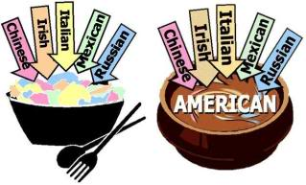
Salad Bowl vs. Melting Pot

Slide 19
Acculturation process
Euphoria 5. Acceptance & Adaptation
3. Initial Adjustment
2. Cultural Shock 4. Alienation

Slide 20
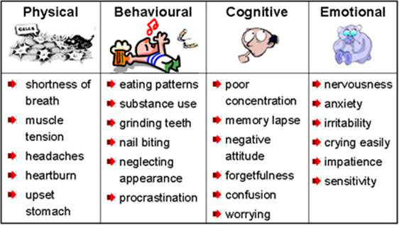
Stress Responses

Slide 21
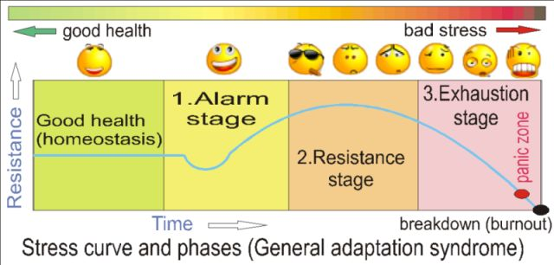
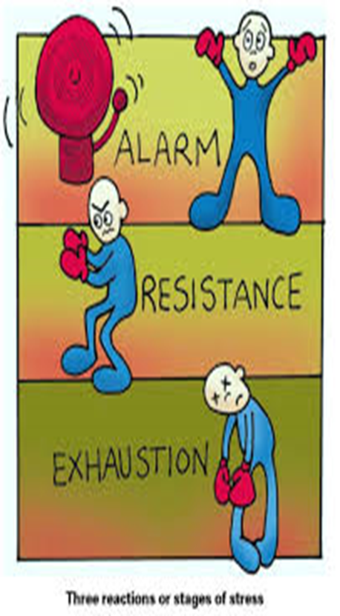
Hans Seley (1956, 1976): General Adaptation Syndrome

Slide 22
Stages of Stress Reaction
Alarm reactions or Emergency Reactions
Encounter or perception of a stressful event leads to disruption of homeostasis Signs: increased heart rate, increased respiration, increased stimulation of adrenaline, headache, loss of appetite etc.
Resistance Stage
During this stage an individual tries to cope or adapt to the stressors.
Signs
Behavioural: Lack of enthusiasm, Withdrawal, Change in eating habits, Insomnia, Anger, Fatigue
Cognitive: Poor problem solving, Confusion, Nightmares, Hyper-vigilance
Emotional: Tearfulness, Fear, Anxiety, Guilt, Agitation, depression etc.

Slide 23
Exhaustion Stage
Decline of resistance
Exhaustion of Resources to Manage Stress
During this stage the stressor is not being managed effectively and the body and mind are not able to repair the damage
Signs: Digestive disorders, Withdrawal, Headaches, Tension, Insomnia, Loss of temper

Slide 24
Major Types of Stress
Frustration
Conflict
Pressure
Change

Slide 25
Impact of Stress
Health
Burnout
PTSD

Slide 26
STRESS OR BURN OUT?
Stress Burnout
Over-engagement Disengagement
Emotions are over-reactive Emotions are blunted
Urgency and hyperactivity Helplessness and hopelessness
Loss of energy Loss of motivation, ideals, and hope
Leads to anxiety disorders Leads to detachment and depression
Primary damage is physical Primary damage is emotional
May kill you prematurely May make life seem not worth living

Slide 27
Factors Influencing Stress Tolerance
Predictability: being able to predict the occurrence of a stressful event-even if the individual cannot control it usually reduces the severity of stress.
Control over Duration: Having control over the duration of a stressful event reduces the severity of the stress.
Cognitive Evaluation: The severity of any stressful event also depends on how person perceives and appraise it.
Social Support: The emotional support and concern of other people can make stress more bearable.

Slide 28
Feeling of Competency
Individual Differences in Reaction to Stress: Optimism, Pessimism and Hardiness: In general, it has been found that optimists (people who have general expectancies of good outcomes) seem to be much more stress resistant than pessimists (people who have general expectancies for poor outcome).
Hardiness is another characteristic that save an individual from harmful effect of stress. Hardy persons show three characteristics
Exhibit higher levels of commitment
They tend to perceive change as a challenge
They have high sense of personal control over events.
Biofeedback

